Slide 1
Implementation of GA analysis
Jake Cooper
jc2088@kent.ac.uk

Slide 2
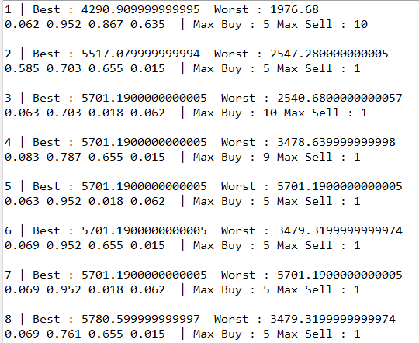
Success of task
Arrived consistently at 2 best solutions
5701.19 ending budget when weight 2 is overwhelmingly chosen (other weights irrelevant)
5780.60 ending budget when weight 2 is highest but all other weights add up to the second weight in total
Possibly due to sample data being easy to predict using only trade breakout rule
Maximum sell amount of best solution always one (best to hold rather than sell)
Higher ending budget possible if buy all at start then hold till the end but this is impossible for this model to achieve
Solution generally achieved within 20 generations

Slide 3

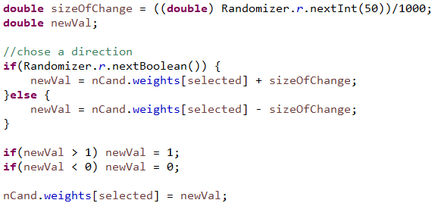
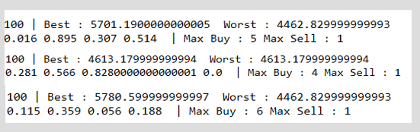
Difficulties during implementation
How to represent weights and budget
Problems with using double (printing / calculations)
How to mutate with doubles
Chose to limit to 3 decimal places
Randomized number from -0.050 to +0.050 (also to 3 decimal places)
Problem likely doesn’t require more than 3 decimal places of accuracy
Simplifies solutions
Mutation like this potential problems
Issues with consistency in GA (lack of exploration after best found)
Probably due to only changing one weight at a time when mutating
Next time I’d mutate each gene with a chance individually
Using same settings

Slide 4
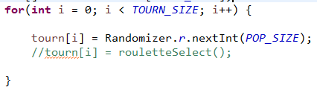

Tweaking of GA
Problems with consistency (mentioned before) means most tweaks were to improve consistency
Fairly high cross over rate increased speed of best solution being found (didn’t help consistency)
“Relatively” high mutation rate helped consistency as best solution required weights 1,3,4 to add to weight 2 exactly
Tournament parameters
Small but not too small tournament size helped weed out the low performing solutions faster
Choosing who goes into the tournament (random or roulette) made little difference to consistency or quality of solution
Ending best parameters
All this was manual tweaking and observing results rather than statistical analysis

